Slide 1
Introduction to Artificial Intelligence
CMPT 310: Summer 2011
Oliver Schulte

Slide 2
topics
Intelligent Agents
uninformed and informed search
Constraint Satisfaction Problems
Game playing
First-order Logic
Reasoning under uncertainty
Bayesian networks
Learning

Slide 3
Course Aims
Assumption:
You will be going off to industry/academia
Will come across computational problems
requiring intelligence (in humans and computers) to solve
Two aims:
Give you an understanding of what AI is
Aims, abilities, methodologies, applications, …
Equip you with techniques for solving problems
By writing/building intelligent software/machines

Slide 4
Computers and Intelligence
Why use computers for intelligent behaviour at all?
They can do some things better than us.
Big calculations quickly and reliably
Search through many options.
Cognitive Science: building intelligent machines helps us understand the nature of intelligence.

Slide 5
Intelligent Behavior: Examples (?)
Learn to flip pancakes
Object Tracking
roboclean talk
roboclean action
Watson Game Show
Watson U.S. cities
Notes:
What do we learn from these examples?
Pancake flipping: teaching is easier than programming. Sensory input is key.
Watson: also uses reinforcement learning, markov decision processes.
Uncertainty has to do with intelligence (knowing what you don’t know). Contrast with dung beetle.

Slide 6
Follow-up: Cleaning Robot and Random Walks
Wikipedia: The Roomba vacuum cleaner (see video) does random exploration, Neato robotics uses SLAM to avoid redundancy.
Advanced math: A random walk after t time steps travels on average a distance of √t.
E.g., to move 10 units, a random walk needs 100 steps.
From a mathematical point of view, a lot of AI is about how to explore a space faster than quadratic.

Slide 7
AI Research at SFU
Various opportunities for funding:
NSERC Undergraduate Research Award. Full-time research in the summer.
Work-study SFU.
Raships from professors.
AI researchers
Richard Vaughan. Robotics.
Anoop Sarkar. Veronica Dahl. Fred Popowich.Linguistics, Machine Translation.
James Delgrande. Logic and AI.
David Mitchell. Eugenia Ternovska. Logic, Theorem Proving, Constraint Satisfaction.
Greg Mori. Vision, Tracking.
Oliver Schulte. Machine Learning, Network Analysis.

Slide 8
What is AI?
Views of AI fall into four categories:
Thinking humanly | Thinking rationally
Acting humanly | Acting rationally
Modern view (ie. Since 1990s): Acting rationally.
In economics and statistics, since the 1920s or earlier.

Slide 9
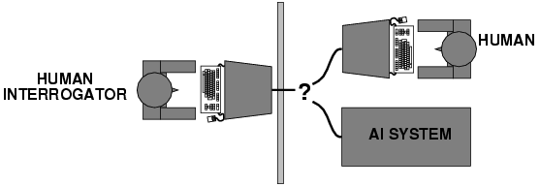
Acting Humanly
Turing (1950) "Computing machinery and intelligence":
"Can machines think?" → "Can machines behave intelligently?”
Skills required:
Natural language processing
Knowledge representation
Automated reasoning
Machine learning
Predicted that by 2000, a machine might have a 30% chance of fooling a lay person for 5 minutes
Cleverbot.
Alice, Kirk
Eliza
Loebner Prize

Slide 10
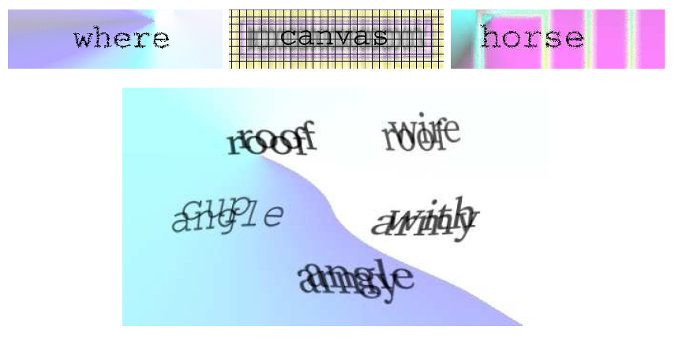
Captcha
Completely Automated Public Turing test to tell Computers and Humans Apart

Slide 11
Thinking humanly: cognitive modeling
Validate thinking in humans
Cognitive science brings together computer models from AI and experimental techniques from psychology to construct the working of the human mind.

Slide 12
Thinking rationally
Aristotle: what are correct arguments/thought processes?
Several Greek schools developed various forms of logic:
notation and rules of derivation for thoughts;
Direct line through mathematics and philosophy to modern AI.

Slide 13
Rational Action
Rational behavior: doing the right thing
The right thing: that which is expected to maximize goal achievement, given the available information
Does it require thinking?
Not always.
Iroboclean?
blinking reflex.
Insects. Do dung beetles think?
Thinking seems to lead to flexibility and robustness.

Slide 14
Inspirations for AI
Major question:
“How are we going to get a machine to
act intelligently to perform complex tasks?”

Slide 15
Inspirations for AI
1. Logic
Studied intensively within mathematics
Gives a handle on how to reason intelligently
Example: automated reasoning
Proving theorems using deduction
http://www.youtube.com/watch?v=3NOS63-4hTQ
Advantage of logic:
We can be very precise (formal) about our programs
Disadvantage of logic:
Not designed for uncertainty.

Slide 16
Inspirations for AI
2. Introspection
Humans are intelligent, aren’t they?
Expert systems
Implement the ways (rules) of the experts
Example: MYCIN (blood disease diagnosis)
Performed better than junior doctors

Slide 17
Inspirations for AI
3. Brains
Our brains and senses are what give us intelligence
Neurologist tell us about:
Networks of billions of neurons
Build artificial neural networks
In hardware and software (mostly software now)
Build neural structures
Interactions of layers of neural networks
http://www.youtube.com/watch?v=r7180npAU9Y&NR=1

Slide 18
Inspirations for AI
4. Evolution
Our brains evolved through natural selection
So, simulate the evolutionary process
Simulate genes, mutation, inheritance, fitness, etc.
Genetic algorithms and genetic programming
Used in machine learning (induction)
Used in Artificial Life simulation

Slide 19
1.2 Inspirations for AI
5. Society
Humans interact to achieve tasks requiring intelligence
Can draw on group/crowd psychology
Software should therefore
Cooperate and compete to achieve tasks
Multi-agent systems
Split tasks into sub-tasks
Autonomous agents interact to achieve their subtask
http://www.youtube.com/watch?v=1Fn3Mz6f5xA&feature=related
http://www.youtube.com/watch?v=Vbt-vHaIbYw&feature=related
Used in movies too.

Slide 20
Rational Agents
An agent is an entity that perceives and acts
This course is about designing rational agents
Abstractly, an agent is a function from percept histories to actions:
[ f: P* → A ]
For any given class of environments and tasks, we seek the agent (or class of agents) with the best performance.
The primary goal is performance, not thinking, consciousness or intelligence. These may be means to achieve performance.
Performance measure is usually given by the user or engineer.
computational limitations make perfect rationality unachievable
→ design best program for given machine resources

Slide 21
AI prehistory
Philosophy
Can formal rules be used to draw valid conclusions?
Where does knowledge come from?
How does knowledge lead into action?
Mathematics/Statistics
What are the formal rules to draw valid conclusion?
How do we reason with uncertain information?
How do intelligent agents learn?
Economics
How should we make decisions to maximize payoff?
How should we do this when others are making decisions too?
Psychology
How do humans and animals think?
Computer
How can we build efficient computers?
Linguistics
How does language relate to thoughts?
knowledge representation, grammar
Notes:
Statistics is missing

Slide 22
Abridged history of AI
1943 McCulloch & Pitts: Boolean circuit model of brain
1950 Turing's "Computing Machinery and Intelligence“
1950s Early AI programs, including Samuel's checkers
1965 Robinson's complete algorithm for logical reasoning
1966—73 AI discovers computational complexity Neural network research almost disappears
1969—79 Early development of knowledge-based systems
1980-- AI becomes an industry
1986-- Neural networks return to popularity
1995-- The emergence of intelligent agents

Slide 23
State-of-the-art
Autonomous planning and scheduling
NASA's Mars Rover on-board program controlled the operations for a spacecraft a hundred million miles from Earth
Game playing:
Deep Blue defeated the world chess champion Garry Kasparov in 1997
Autonomous control
No hands across America (driving autonomously 98% of the time from Pittsburgh to San Diego)
Logistic planning
During the 1991 Gulf War, US forces deployed an AI logistics planning and scheduling program that involved up to 50,000 vehicles, cargo, and people
Language understanding and problem solving
solves crossword puzzles better than most humans

